Slide 1
Chapter 8
Fundamental Sampling Distributions and Data Descriptions
Chapter 8
Fundamental Sampling Distributions and Data Descriptions

Slide 2
Chapter 8.1
Random Sampling
Populations and Samples
A population consists of the totality of the observations with which we are concerned.
A population is the entire group we are interested in, which we wish to describe or draw conclusions about.
A sample is a subset of a population.
In the field of statistical inference, the statistician is interested in arriving at conclusions concerning a population when it is impossible or impractical to observe the entire set of observations that make up the population.
This brings us to consider the notion of sampling.
In order to obtain valid inference about a population, the samples must be representative of the population.

Slide 3
Chapter 8.1
Random Sampling
Random Sampling
Any sampling procedure that produces inferences that consistently overestimate or consistently underestimate some characteristic of the population is said to be biased.
To eliminate any possibility of bias in the sampling procedure, it is desirable to choose a random sample in the sense that the observations are made independently and at random.
Let X₁, X₂,..., X_{n} be n independent random variables, each having the same probability distribution f(x). We then define X₁, X₂,..., X_{n} to be a random sample of size n from the population f(x) and write its joint probability distribution as

Slide 4
Chapter 8.1
Random Sampling
Random Sampling
If one makes a random selection of n = 8 storage batteries from a manufacturing process, which has maintained the same specifications, and records the length of life for each battery with the first measurement x₁ being a value of X₁, the second measurement x₂ a value of X₂, and so forth, then x₁, x₂,..., x₈ are the values of the random sample X₁, X₂,..., X₈.
If we assume the population of battery lives to be normal, the possible values of any X_{i}, i = 1, 2,..., 8 will be precisely the same as those in the original population, and hence X_{i} has the same identical normal distribution as X.

Slide 5
Chapter 8.2
Some Important Statistics
Random Sampling
Suppose we wish to arrive at a conclusion concerning the proportion of coffee-drinking people in the US who prefer a certain brand of coffee. It is impossible to compute the value of the parameter p that represents the population proportion.
Instead, we select a representative random sample, and can easily calculate the proportion p of people in this sample favoring a certain brand of coffee.
The value p is now used to make an inference concerning the true proportion p.
Why?
^
^
^
p is a function of the observed values in the random sample.
Many random sample are possible to be taken from the population, and p would vary from sample to sample.
p is a value of a random variable that is represented by P.
^
^
^
Any function of the random variables that constitutes (or contains) a random sample is called a statistic.

Slide 6
Chapter 8.2
Some Important Statistics
Sample Mean and Sample Variance
If X₁, X₂,..., X_{n} represent a random sample of size n, then the sample mean is defined by the statistic
If X₁, X₂,..., X_{n} represent a random sample of size n, then the sample variance is defined by the statistic

Slide 7
Chapter 8.2
Some Important Statistics
Some Important Statistics
A comparison of coffee prices at 4 randomly selected grocery stores in San Diego showed increases from the previous month of 12, 15, 17, and 20 cents for a 1-pound bag.
Find the mean and the variance of this random sample of price increases.

Slide 8
Chapter 8.2
Some Important Statistics
Sample Variance and Sample Standard Deviation
If S² is the variance of a random sample of size n, we may write
The sample standard deviation, denoted by S, is the positive square root of the sample variance.
Find the variance of the data 3, 4, 5, 6, 6, and 7, representing the number of trout caught by a random sample of 6 fishermen on June 19, 1996, at Lake Muskoka.
Can you calculate with the first formula?

Slide 9
Chapter 8.4
Sampling Distributions
Sampling Distributions
The field of statistical inference is basically concerned with generalizations and predictions.
For each sample selected from the population we can compute statistics (i.e., the sample parameters) , and from these statistics we made various statements concerning the values of the population parameters that may or may not be true.
Since a statistic is a random variable that depends only on the observed sample, it must have a probability distribution.
The probability distribution of a statistic is called a sampling distribution.
_
The probability distribution of X is called the sampling distribution of the mean, etc.
The sampling distribution of a statistic depends on the size of the population, the size of the samples, and the method of choosing the samples.

Slide 10
Chapter 8.4
Sampling Distributions
_
Sampling Distribution of X and S²
_
One should view that the sampling distribution of X and S² are the mean with which we eventually make inferences on the parameters μ and σ².
_
The sampling distribution of X with sample size n is the distribution that results when an experiment is conducted over and over again (always with sample size n) and the many values of X result.
This sampling distribution, then, describes the variability of sample mean around the true population mean μ.
_
The same principle applies in the case of the distribution of S². The sampling distribution produces information about the variability of s² values around σ² in repeated experiments.

Slide 11
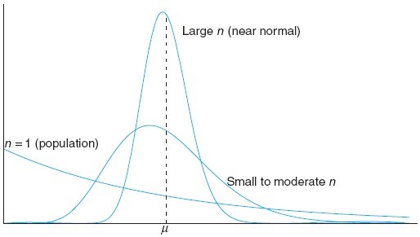
Chapter 8.5
Sampling Distribution of Means
Sampling Distribution of Means
Central Limit Theorem. If X is the mean of a random sample of size n taken from a population with mean μ and finite variance σ², then the limiting form of the distribution of
as n → ∞, is the standard normal distribution n(z; 0, 1).

Slide 12
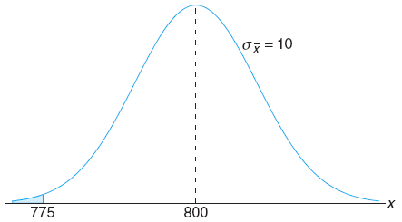
Chapter 8.5
Sampling Distribution of Means
Sampling Distribution of Means
An electrical firm manufactures light bulbs that have a length of life that is approximately normally distributed, with mean equal to 800 hours and a standard deviation of 40 hours. Find the probability that a random sample of 16 bulbs will have an average life of less than 775 hours.
It is very unlikely that the mean life of the light bulbs is less then 775 hours, should the claim of 800 mean life be true.

Slide 13
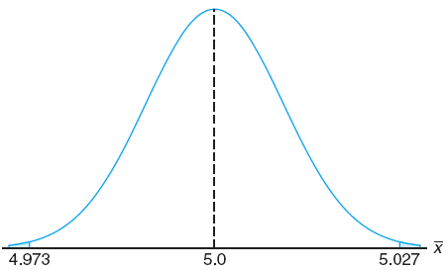
Chapter 8.5
Sampling Distribution of Means
Sampling Distribution of Means
An important manufacturing process produces cylindrical components parts for the automotive industry. It is important that the process produce parts having a mean of 5 mm. An experiment is conducted in which 100 parts produced by the process are selected randomly and the diameter measured on each.
It is known that the population standard deviation σ = 0.1. The experiment indicates a sample average diameter x = 5.027 mm. Does this sample information appears to support or refute the engineer’s conjecture?
_

Slide 14
Chapter 8.5
Sampling Distribution of Means
Sampling Distribution of Means
_
Someone would experience by chance an x that is 0.027 mm from the mean μ in only 7 in 1000 experiments.
As a result, this experiment with x = 5.027 certainly does not give supporting evidence to the conjecture that μ = 5.
In fact it strongly refutes the conjecture.
_

Slide 15
Chapter 8.5
Sampling Distribution of Means
Sampling Distribution of Means
If independent samples size n₁ and n₂ are drawn at random from two populations, discrete or continuous, with means μ₁ and μ₂ and variances σ₁² and σ₂², respectively, then the sampling distribution of the differences of means, X₁ – X₂, is approximately normally distributed with mean and variance given by
_
_
and
Hence,
is approximately a standard normal variable.

Slide 16
Chapter 8.5
Sampling Distribution of Means
Sampling Distribution of Means
Two independent experiments are being run in which two different types of paints are compared. Eighteen specimens are painted using type A and the drying time in hours is recorded on each. The same is done with type B. The population standard deviations are both known to be 1.0.
Assuming that the mean drying time is equal for the two types of paint, find P(X_{A}–X_{B}>1.0), where X_{A} and X_{B} are the average drying times for samples of size n_{A} = n_{B} = 18.

Slide 17
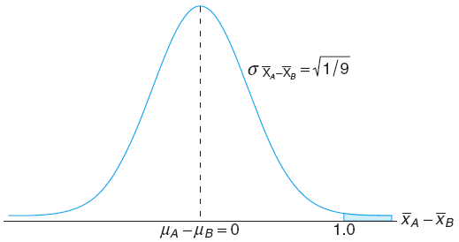
Chapter 8.5
Sampling Distribution of Means
Sampling Distribution of Means
The paints are unlikely to be dried with a time difference of 1 hour, if their mean drying time is equal.
Should in the reality the difference is measured to be 1 hour, then the assumption that μ_{A} = μ_{B} is questionable.

Slide 18
Chapter 8.5
Sampling Distribution of Means
Sampling Distribution of Means
With the same example as before, what difference can be inferred if the difference in the two sample averages is only 15 minutes instead of 1 hour?
In 22.66% of the time, the paint A will dried 15 minutes longer than paint B, although their means are the same.
The difference in sample means of 15 minutes can happen by chance, 22.66% even though μ_{A} = μ_{B}.
As a result, that type of difference in average drying time certainly is not a clear indication that μ_{A} ≠ μ_{B}.

Slide 19
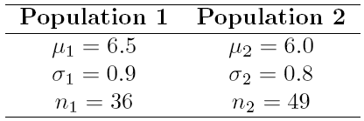
Chapter 8.5
Sampling Distribution of Means
Sampling Distribution of Means
The television picture tubes of manufacturer A has a mean lifetime of 6.5 years and a standard deviation of 0.9 year, while those of manufacturer B has a mean lifetime of 6.0 years and a standard deviation of 0.8 year.
What is the probability that a random sample of 36 tubes from manufacturer A will have a mean lifetime that is at least 1 year more than the mean lifetime of a sample of 49 tubes from manufacturer B?

Slide 20
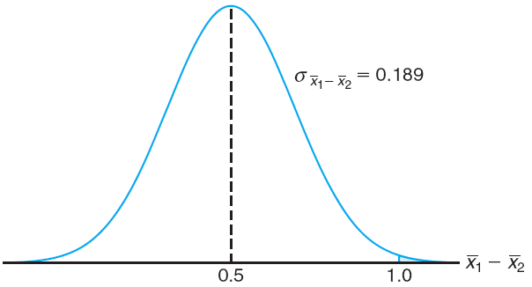
Chapter 8.5
Sampling Distribution of Means
Sampling Distribution of Means
It is almost impossible (only by 0.4% chance) that the mean lifetime of the tube of manufacturer A will be 1 year longer than that of manufacturer B.
They are more probably to differ around 0.5 year, as given by the difference of the population means.

Slide 21
Probability and Statistics
Homework 9A
An company manufactures light bulbs that have a mean operating voltage of 100 volts and a standard deviation of 10 volts. The distribution of light bulb voltage is normal. Find the probability that a random sample of 25 light bulbs will have an average operating voltage less than 95 volts. (Mont.E7.13)
A first random sample of size 36 is taken from a normal population having a mean of 75 and a standard deviation of 3. A second random sample of size 25 is taken from another normal population having a mean of 80 and a standard deviation of 5.
Find the probability that the sample mean computed from second population will exceed the sample mean computed from the first population by at least 3.4 but less than 5.9. (Wal8.828)

Slide 22
Chapter 8.6
Sampling Distribution of S²
Sampling Distribution of S²
If S² is the variance of a random sample of size n taken from a normal population having the variance σ², then the statistic
has a chi-squared distribution with v = n – 1 degrees of freedom.

Slide 23
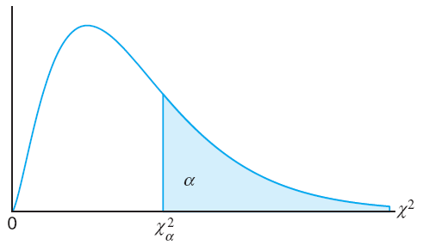
Chapter 8.6
Sampling Distribution of S²
Sampling Distribution of S²
Table A.5 gives values of for various values of α and v.
The column headings are the areas α.
The left column shows the degrees of freedom.
The table entry are the value.

Slide 24
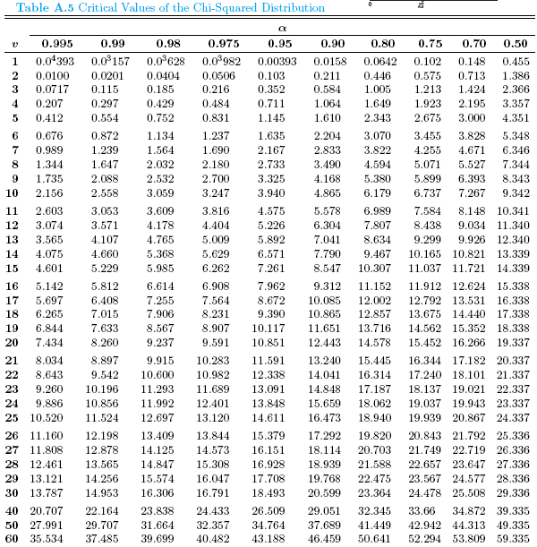
Chapter 8.6
Sampling Distribution of S²
Table A.5 Chi-Squared Distribution

Slide 25
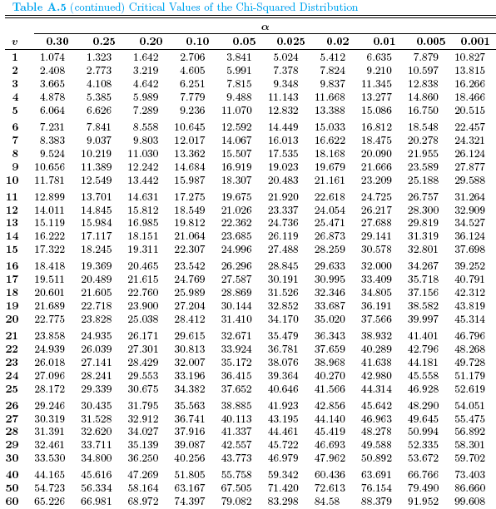
Chapter 8.6
Sampling Distribution of S²
Table A.5 Chi-Squared Distribution

Slide 26
Chapter 8.6
Sampling Distribution of S²
Sampling Distribution of S²
A manufacturer of car batteries guarantees that his batteries will last, on the average, 3 years with a standard deviation of 1 year. If five of these batteries have lifetimes of 1.9, 2.4, 3.0, 3.5, and 4.2 years, is the manufacturer still convinced that his batteries have a standard deviation of 1 year? Assume that the battery lifetime follows a normal distribution.
From the table, 95% of the χ² values with 4 degrees of freedom fall between 0.484 and 11.143.
The computed value with σ² = 1 is reasonable.
The manufacturer has no reason to doubt the current standard deviation.

